Slide 1
TELCO CUSTOMER ANALYTICS
By Vinh Vu
LinkedIn: https://www.linkedin.com/in/vinh-v-0b9059163/

Slide 2
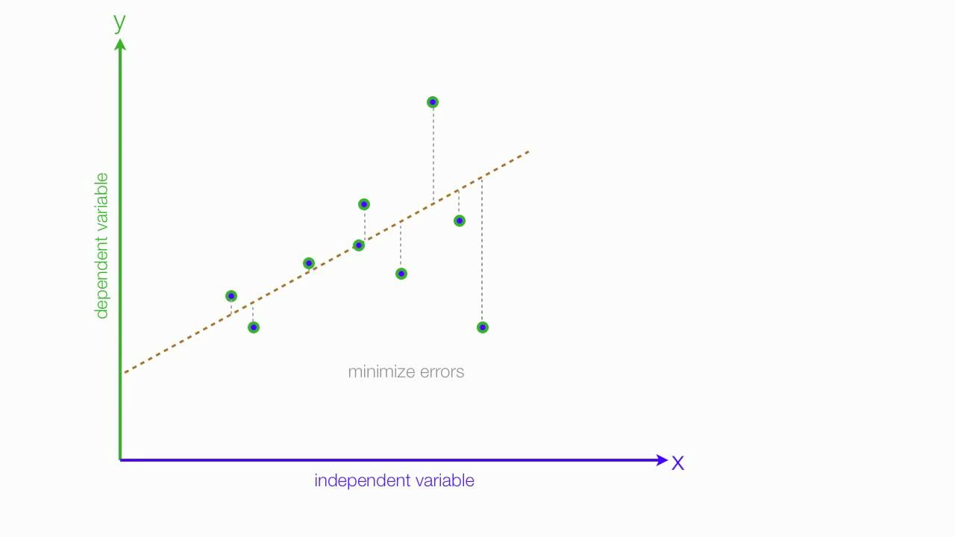
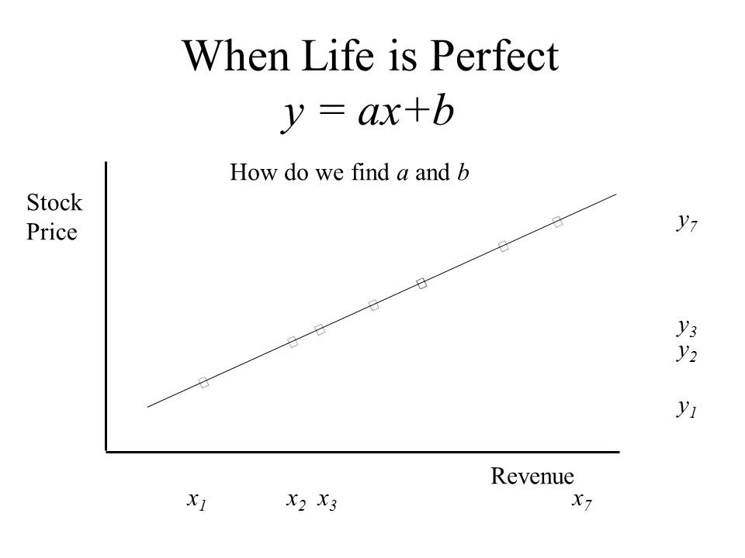
Machine learning
A regression problem is when the output variable is a real or continuous value, such as “salary” or “weight”. Many different models can be used, the simplest is the linear regression. It tries to fit data with the best hyper-plane which goes through the points.

Slide 3
About the project:
My client, Telco Company, is a telephone and internet service provider with over 5000 customers. In order to grow and maintain profitability, it’s essential that they learn how to maintain a dedicated customer base and reduce churn. Based on my analysis, Telco can:
Identify customers that are likely to churn and reach out to them to try to stop them from churning via special offers targeted to their needs
Focus marketing on customers that are more likely to be long term customers
Modify their services to improve the likelihood customers will stay longer term

Slide 4
Data set
Attribute | Description
CustomerID | Customer ID
Gender | Customer gender (female, male)
SeniorCitizen | Whether the customer is a senior citizen or not (1, 0)
Partner | Whether the customer has a partner or not (Yes, No)
Dependents | Whether the customer has dependents or not (Yes, No)
Tenure | Number of months the customer has stayed with the company
PhoneService | Whether the customer has a phone service or not (Yes, No)
MultipleLines | Whether the customer has multiple lines or not (Yes, No, No phone service)
InternetService | Customer’s internet service provider (DSL, Fiber optic, No)
OnlineSecurity | Whether the customer has online security or not (Yes, No, No internet service)
OnlineBackup | Whether the customer has online backup or not (Yes, No, No internet service)
DeviceProtection | Whether the customer has device protection or not (Yes, No, No internet service)
TechSupport | Whether the customer has tech support or not (Yes, No, No internet service)
StreamingTV | Whether the customer has streaming TV or not (Yes, No, No internet service)
StreamingMovies | Whether the customer has streaming movies or not (Yes, No, No internet service)
Contract | The contract term of the customer (Month-to-month, One year, Two year)
PaperlessBilling | Whether the customer has paperless billing or not (Yes, No)
PaymentMethod | The customer’s payment method (Electronic check, Mailed check, Bank transfer (automatic), Credit card (automatic))
MonthlyCharges | The amount charged to the customer monthly
TotalCharges | The total amount charged to the customer
Churn | Whether the customer churned or not (Yes or No)

Slide 5
Constructing the Data:
Convert columns with yes/ no to 1/0
When a column has multiple values, I use get_dummy turning a column to multiple columns
Customer ID | automatic desposit | cash | check
4562 | 1 | 0 | 0
4563 | 0 | 1 | 0
4564 | 0 | 0 | 1
4566 | 1 | 0 | 0
4567 | 0 | 1 | 0
4568 | 0 | 0 | 1
Customer ID | Payment Type
4562 | automatic desposit
4563 | cash
4564 | check
4566 | automatic desposit
4567 | cash
4568 | check

Slide 6
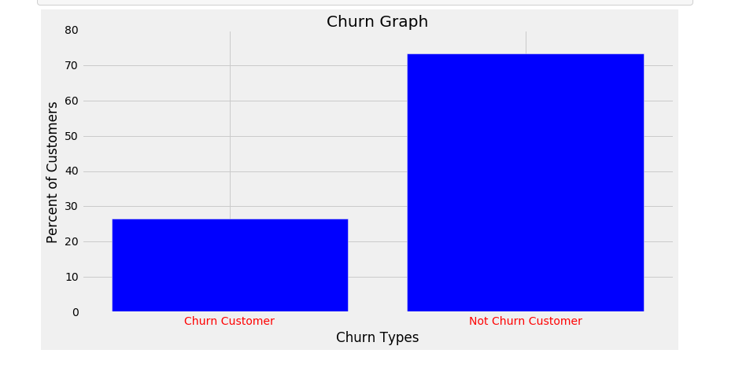
Exploring the Data

Slide 7
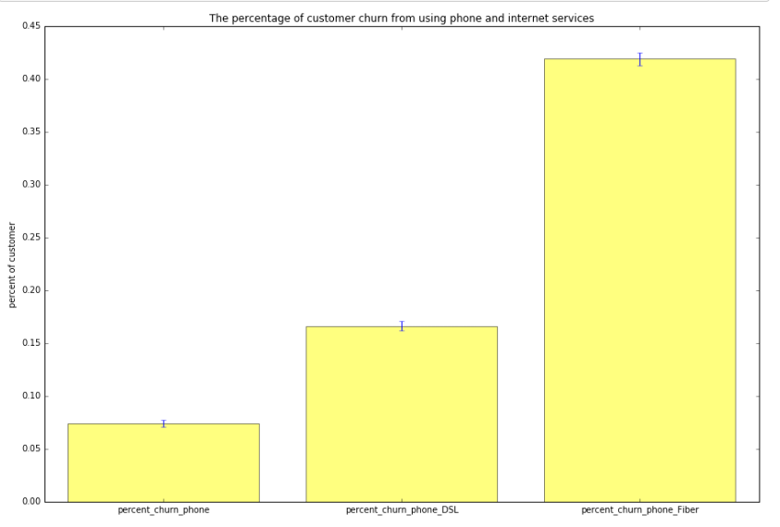
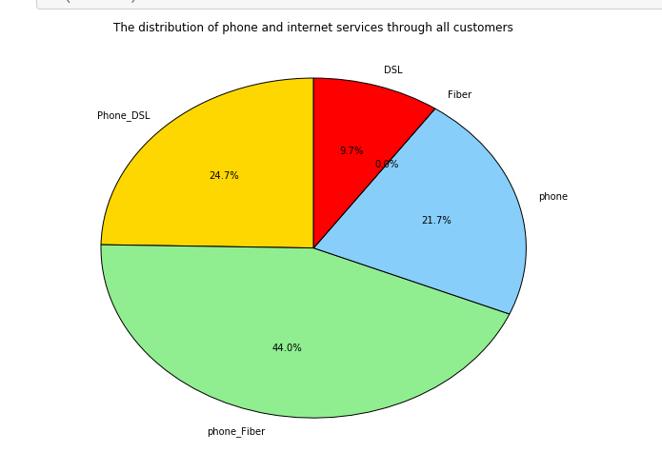
Services:

Slide 8
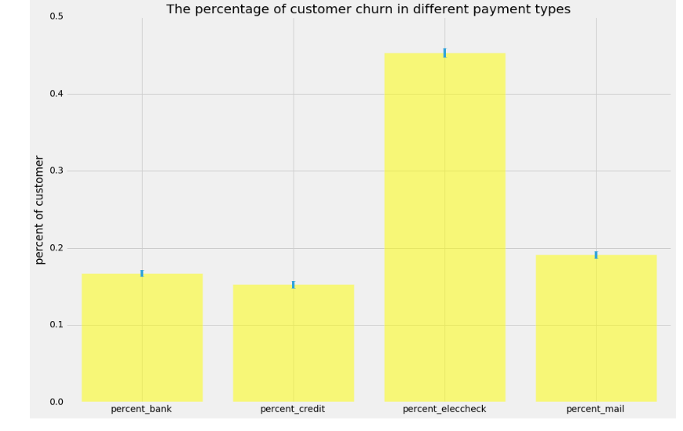
Payment types:

Slide 9
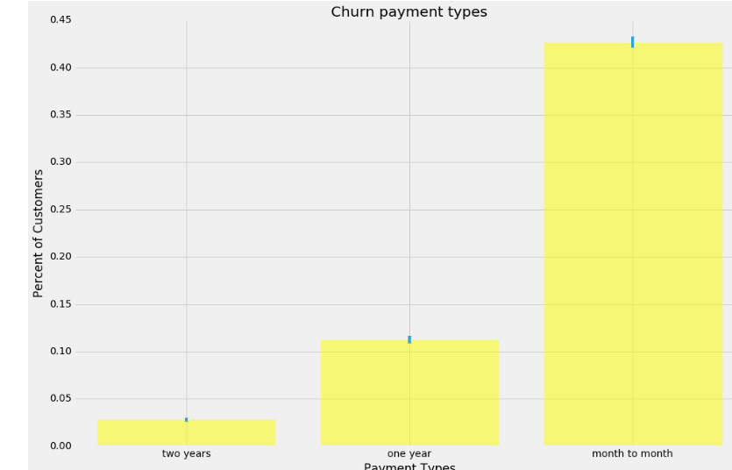
Payment types:

Slide 10
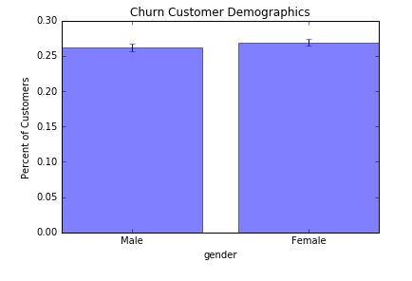
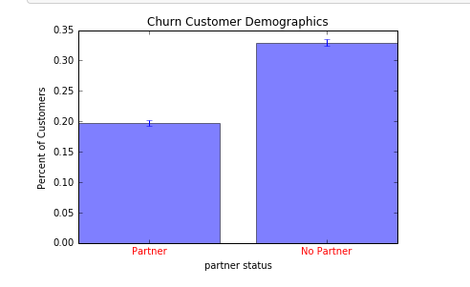
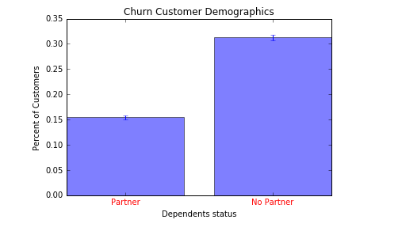
Demographic:

Slide 11
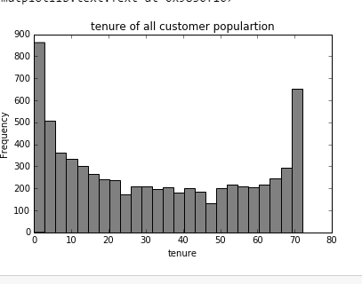
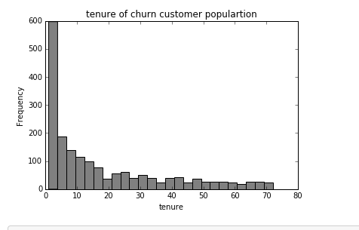
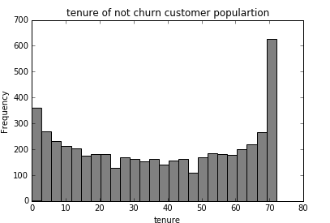
Tenure:

Slide 12
Machine learning:
Due to skewed distribution of customers who churn and don’t churn, the data set is an imbalanced problem. Imbalanced data typically refers to a problem with classification problems where the classes are not represented equally. In order to face imbalanced class, we measure model performance through different errors and concepts; such as Precision, recall. Due to this project, it is a binary class problem. Precision and recall are very important , because Precision is sort of like accuracy but it looks only at the data you predicted positive (in this example you’re only looking at data where you predict a churn) and the recall is also sort of like accuracy but it looks only at the data that is “relevant” in some way.
Due this project is classification problem, I will use grid search in order to find the best parameter. Then it is used other models like logistic regression , random forest and decision tree in order to find the best fit model.

Slide 13
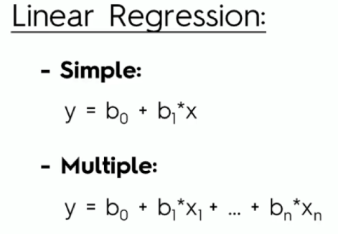
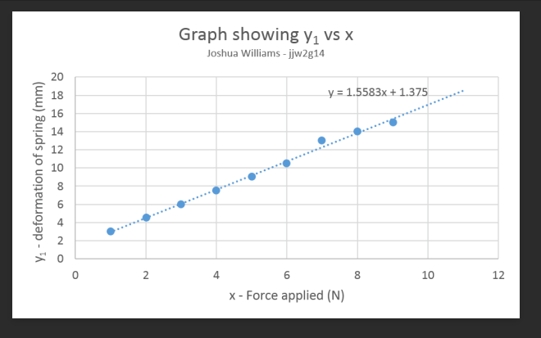
Logistic regression:

Slide 14
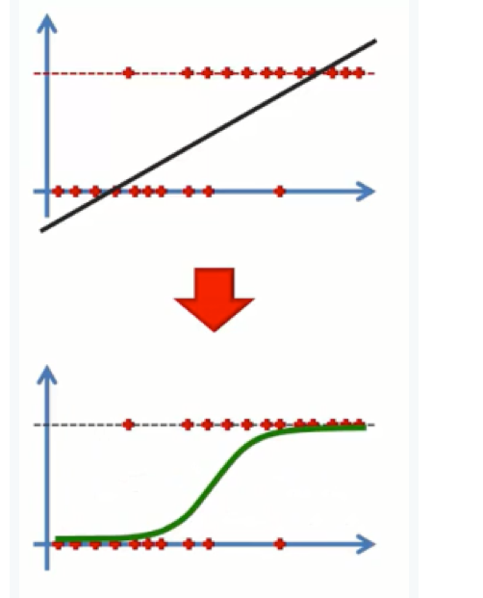
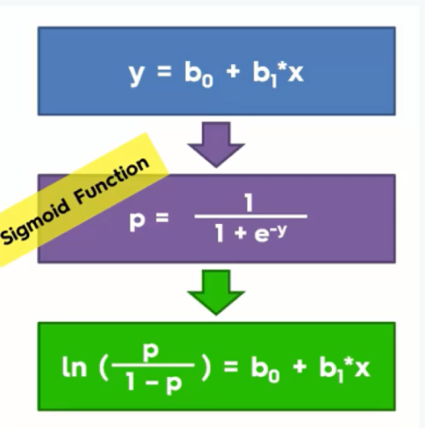
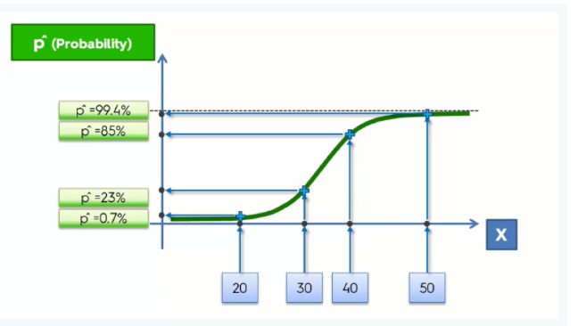
Logistic regression:

Slide 15

Random forest:

Slide 16
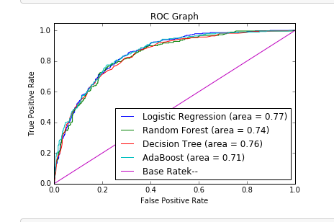
ROC curve:
In a Receiver Operating Characteristic (ROC) curve the true positive rate (Sensitivity) is plotted in function of the false positive rate (100-Specificity) for different cut-off points. Each point on the ROC curve represents a sensitivity/specificity pair corresponding to a particular decision threshold. A test with perfect discrimination (no overlap in the two distributions) has a ROC curve that passes through the upper left corner (100% sensitivity, 100% specificity). Therefore the closer the ROC curve is to the upper left corner, the higher the overall accuracy of the test (Zweig & Campbell, 1993). According to our ROC graph, the logistic regression has a best fit model for this problem because AUC =0.77

Slide 17
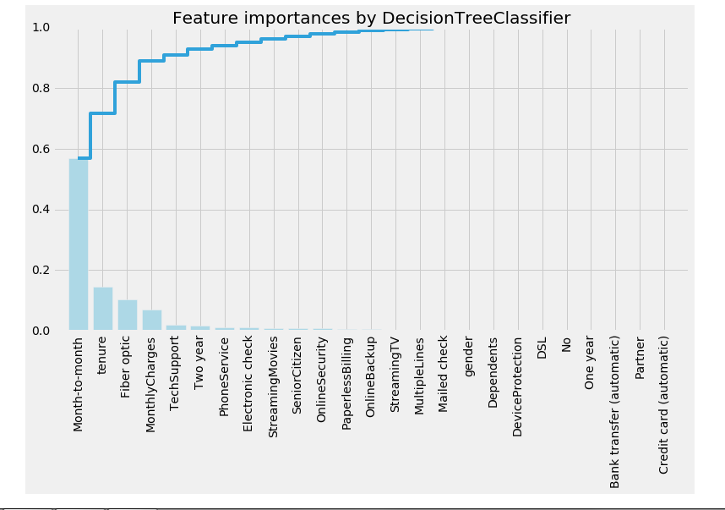
Feature important:

Slide 18
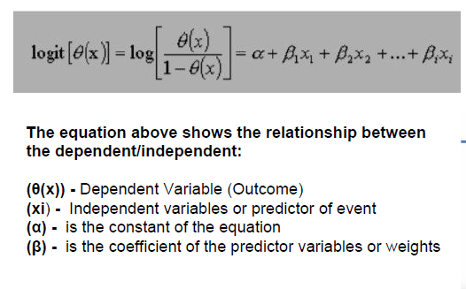
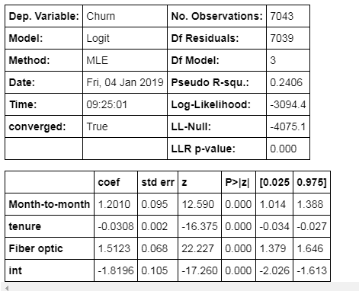
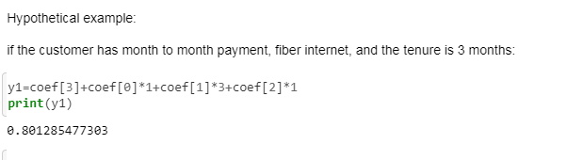
Probability of customer churn:

Slide 19
Conclusion:
In summary, this is what we know about why customers churn:
Customer are most likely to churn if they are the month to month payment type.
Customer is likely to churn in first ten months.
Customers is likely to leave when they use Fiber optic service.
there is 0% customers use fiber only, customers are likely to cancel services when they use phone and fiber.
Customers with no partner or dependent are more likely to churn
month to month, tenure, and fiber optic are the three most significant features in determining churn.
Using the Logistic Regression model built to classify churn, wee can determine the probability each customer will churn. Telco can use this knowledge both to offer an array of products and services more likely to retain customers, and also use this knowledge to allocate resources to provide services specifically aimed at customers likely to churn so they won’t leave. One primary weakness in this analysis, is that we cannot predict the exact timeframe in which a customer would leave, a next step in this analysis would be to take this into account using a time series based approach.

